Slide 1


Object Oriented Programming and Design WEEK 5 – Inheritance and Polymorphism

Slide 2
Revision Topic
Classes and objects in Java
Java Methods
Variables in Java
Java Class Constructor
Java Access Modifiers
Four pillars of OOP
Encapsulation in Java

Slide 3
LET’S GET STARTED WITH LECTURE 5

Slide 4
Inheritance in Java

Slide 5
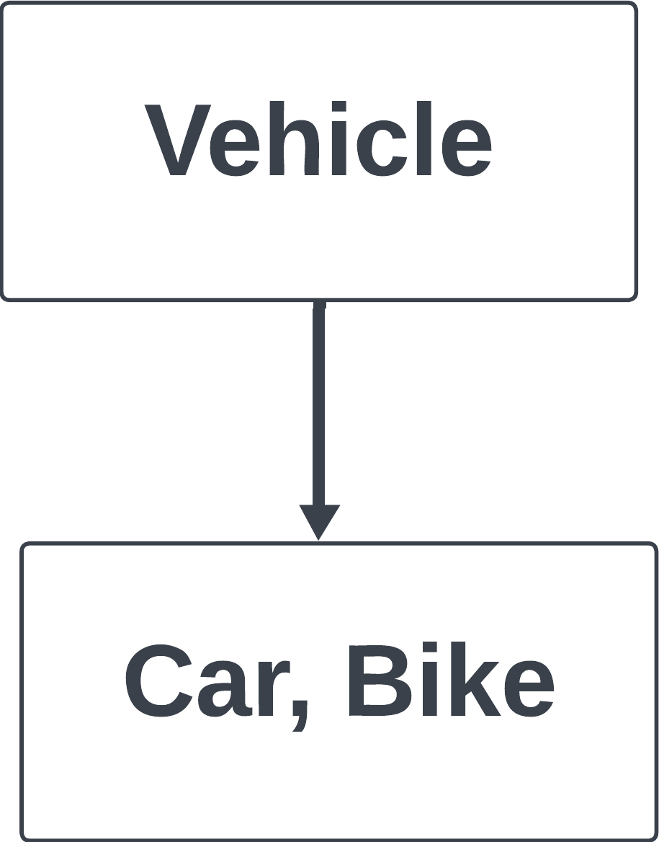
1.Inheritance in java
1.1. Class declaration in java inheritance
1.2. Importance of Inheritance
1.3. Super class
1.4. Sup class
1.4. Protected class in Java
2. Types of Inheritance
2.1. Single inheritance
2.2. Multi-level inheritance
2.3. Hierarchical inheritance
2.4. Hybrid inheritance
3. Super Keyword in Java
3.1. Usage of Super in Java
4. Refer immediate parent class instance variable
5. Refer immediate parent class method
6. Invoke parent class constructor
7.Polymorphism in Java
7.1. Advantages of Polymorphism
7.2. Disadvantages of Polymorphism
8. Types of Polymorphism
8.1. Static Binding
8.1.1. Method Overloading
8.2. Dynamic Binding
8.2.1. Method Overriding
8.3. Static Binding vs Dynamic Binding
9. Final Keyword
Inheritance in Java
“Inheritance represents the IS-A relationship between two classes .”
Inheritance in Java is a mechanism in which one object acquires all the properties and behaviors of a parent object.
For example:
Bike and car this are vehicle.
The child of vehicle are bike
and car. And, vehicle is the
parent.

Slide 6
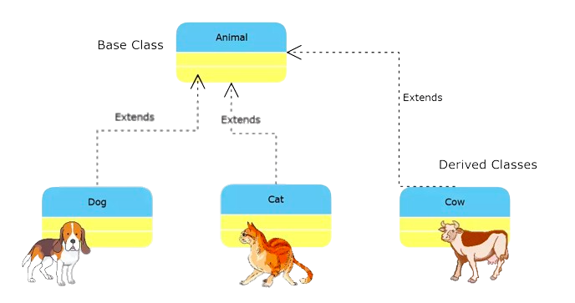
1.Inheritance in java
1.1. Class declaration in java inheritance
1.2. Importance of Inheritance
1.3. Super class
1.4. Sup class
1.4. Protected class in Java
2. Types of Inheritance
2.1. Single inheritance
2.2. Multi-level inheritance
2.3. Hierarchical inheritance
2.4. Hybrid inheritance
3. Super Keyword in Java
3.1. Usage of Super in Java
4. Refer immediate parent class instance variable
5. Refer immediate parent class method
6. Invoke parent class constructor
7.Polymorphism in Java
7.1. Advantages of Polymorphism
7.2. Disadvantages of Polymorphism
8. Types of Polymorphism
8.1. Static Binding
8.1.1. Method Overloading
8.2. Dynamic Binding
8.2.1. Method Overriding
8.3. Static Binding vs Dynamic Binding
9. Final Keyword
Class declaration in Java
The parent class is known as-
Base Class / Super class
The child class is known as-
Derived class/ Sub Class

Slide 7
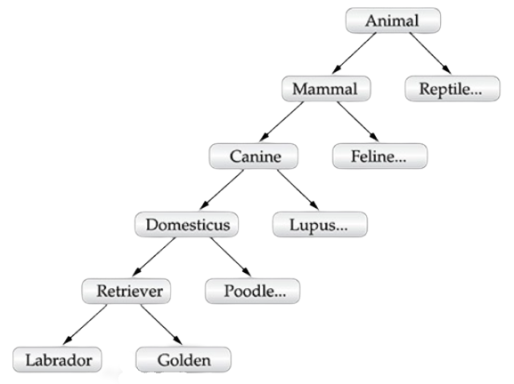
1.Inheritance in java
1.1. Class declaration in java inheritance
1.2. Importance of Inheritance
1.3. Super class
1.4. Sup class
1.4. Protected class in Java
2. Types of Inheritance
2.1. Single inheritance
2.2. Multi-level inheritance
2.3. Hierarchical inheritance
2.4. Hybrid inheritance
3. Super Keyword in Java
3.1. Usage of Super in Java
4. Refer immediate parent class instance variable
5. Refer immediate parent class method
6. Invoke parent class constructor
7.Polymorphism in Java
7.1. Advantages of Polymorphism
7.2. Disadvantages of Polymorphism
8. Types of Polymorphism
8.1. Static Binding
8.1.1. Method Overloading
8.2. Dynamic Binding
8.2.1. Method Overriding
8.3. Static Binding vs Dynamic Binding
9. Final Keyword

Slide 8
1.Inheritance in java
1.1. Class declaration in java inheritance
1.2. Importance of Inheritance
1.3. Super class
1.4. Sup class
1.4. Protected class in Java
2. Types of Inheritance
2.1. Single inheritance
2.2. Multi-level inheritance
2.3. Hierarchical inheritance
2.4. Hybrid inheritance
3. Super Keyword in Java
3.1. Usage of Super in Java
4. Refer immediate parent class instance variable
5. Refer immediate parent class method
6. Invoke parent class constructor
7.Polymorphism in Java
7.1. Advantages of Polymorphism
7.2. Disadvantages of Polymorphism
8. Types of Polymorphism
8.1. Static Binding
8.1.1. Method Overloading
8.2. Dynamic Binding
8.2.1. Method Overriding
8.3. Static Binding vs Dynamic Binding
9. Final Keyword
Java Inheritance:
The importance of inheritance in java program is code reusability. We can reuse the function of parent class at child class.
• In java we use Extends keyword for inheritance.
• Subclass and Superclass in inheritance.

Slide 9
1.Inheritance in java
1.1. Class declaration in java inheritance
1.2. Importance of Inheritance
1.3. Super class
1.4. Sub class
1.4. Protected class in Java
2. Types of Inheritance
2.1. Single inheritance
2.2. Multi-level inheritance
2.3. Hierarchical inheritance
2.4. Hybrid inheritance
3. Super Keyword in Java
3.1. Usage of Super in Java
4. Refer immediate parent class instance variable
5. Refer immediate parent class method
6. Invoke parent class constructor
7.Polymorphism in Java
7.1. Advantages of Polymorphism
7.2. Disadvantages of Polymorphism
8. Types of Polymorphism
8.1. Static Binding
8.1.1. Method Overloading
8.2. Dynamic Binding
8.2.1. Method Overriding
8.3. Static Binding vs Dynamic Binding
9. Final Keyword
Parent class/ Super class/ Base class
//Super Class
class Vehicle
{
protected String brand = "Ford";
public void honk() {
System.out.println("Tuut, tuut!");
}
}

Slide 10
1.Inheritance in java
1.1. Class declaration in java inheritance
1.2. Importance of Inheritance
1.3. Super class
1.4. Sub class
1.4. Protected class in Java
2. Types of Inheritance
2.1. Single inheritance
2.2. Multi-level inheritance
2.3. Hierarchical inheritance
2.4. Hybrid inheritance
3. Super Keyword in Java
3.1. Usage of Super in Java
4. Refer immediate parent class instance variable
5. Refer immediate parent class method
6. Invoke parent class constructor
7.Polymorphism in Java
7.1. Advantages of Polymorphism
7.2. Disadvantages of Polymorphism
8. Types of Polymorphism
8.1. Static Binding
8.1.1. Method Overloading
8.2. Dynamic Binding
8.2.1. Method Overriding
8.3. Static Binding vs Dynamic Binding
9. Final Keyword
Sub class/ Child class/ Derived class
//Sub class
class Car extends Vehicle
{
private String modelName = "Mustang";
public static void main(String[] args) {
Car myFastCar = new Car();
myFastCar.honk();
System.out.println(myFastCar.brand + " " + myFastCar.modelName);
}
}
Output:
Tuut, tuut!
Ford Mustang

Slide 11
1.Inheritance in java
1.1. Class declaration in java inheritance
1.2. Importance of Inheritance
1.3. Super class
1.4. Sub class
1.4. Protected class in Java
2. Types of Inheritance
2.1. Single inheritance
2.2. Multi-level inheritance
2.3. Hierarchical inheritance
2.4. Hybrid inheritance
3. Super Keyword in Java
3.1. Usage of Super in Java
4. Refer immediate parent class instance variable
5. Refer immediate parent class method
6. Invoke parent class constructor
7.Polymorphism in Java
7.1. Advantages of Polymorphism
7.2. Disadvantages of Polymorphism
8. Types of Polymorphism
8.1. Static Binding
8.1.1. Method Overloading
8.2. Dynamic Binding
8.2.1. Method Overriding
8.3. Static Binding vs Dynamic Binding
9. Final Keyword
Protected Class in Java
The protected keyword is an access modifier used for attributes, methods and constructors, making them accessible within package and outside the package but through inheritance only.

Slide 12
//save by A.java
package pack;
public class A{
protected void msg(){System.out.println("Hello");}
}
//save by B.java
package mypack;
import pack.*;
class B extends A{
public static void main(String args[]){
B obj = new B();
obj.msg();
}
}

Slide 13
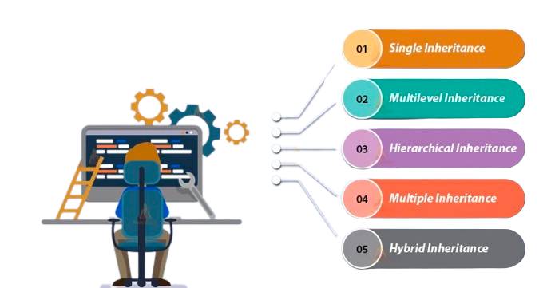
1.Inheritance in java
1.1. Class declaration in java inheritance
1.2. Importance of Inheritance
1.3. Super class
1.4. Sub class
1.4. Protected class in Java
2. Types of Inheritance
2.1. Single inheritance
2.2. Multi-level inheritance
2.3. Hierarchical inheritance
2.4. Hybrid inheritance
3. Super Keyword in Java
3.1. Usage of Super in Java
4. Refer immediate parent class instance variable
5. Refer immediate parent class method
6. Invoke parent class constructor
7.Polymorphism in Java
7.1. Advantages of Polymorphism
7.2. Disadvantages of Polymorphism
8. Types of Polymorphism
8.1. Static Binding
8.1.1. Method Overloading
8.2. Dynamic Binding
8.2.1. Method Overriding
8.3. Static Binding vs Dynamic Binding
9. Final Keyword
Types of Inheritance

Slide 14
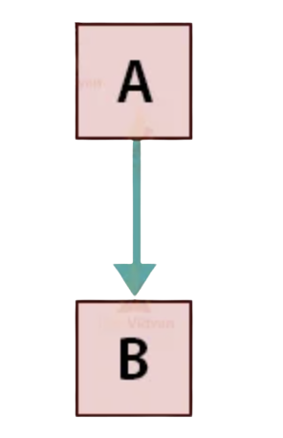
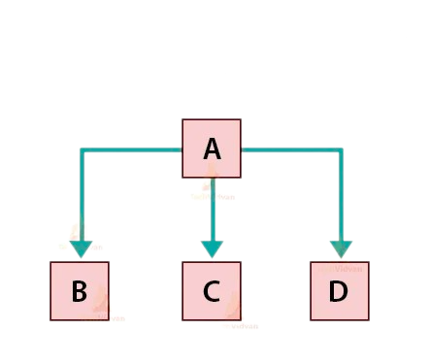
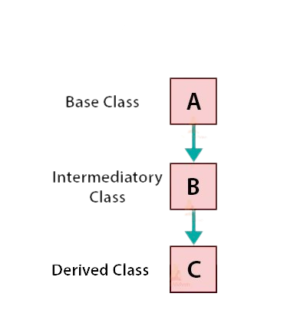
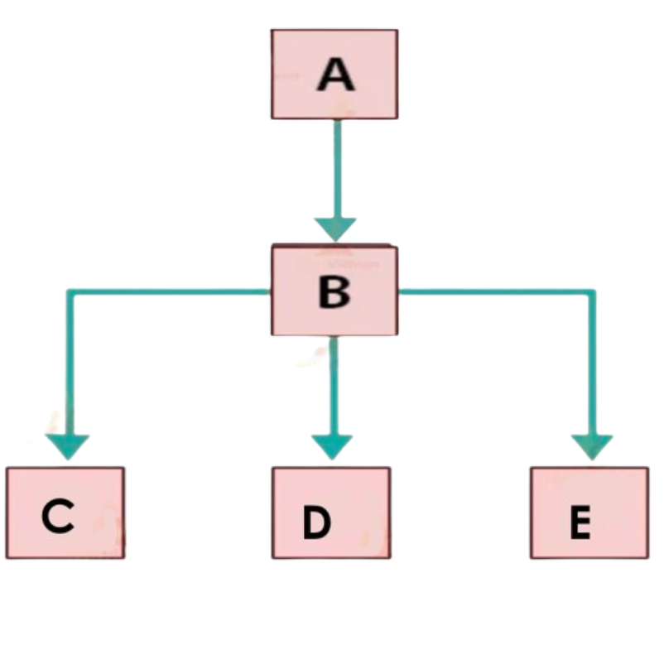
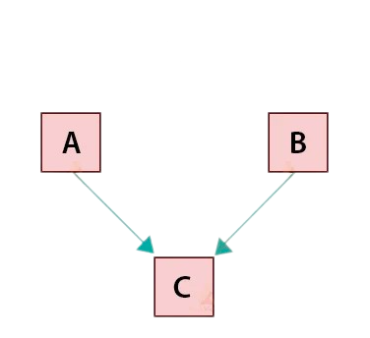
Types of Inheritance
1.Inheritance in java
1.1. Class declaration in java inheritance
1.2. Importance of Inheritance
1.3. Super class
1.4. Sub class
1.4. Protected class in Java
2. Types of Inheritance
2.1. Single inheritance
2.2. Multi-level inheritance
2.3. Hierarchical inheritance
2.4. Hybrid inheritance
3. Super Keyword in Java
3.1. Usage of Super in Java
4. Refer immediate parent class instance variable
5. Refer immediate parent class method
6. Invoke parent class constructor
7.Polymorphism in Java
7.1. Advantages of Polymorphism
7.2. Disadvantages of Polymorphism
8. Types of Polymorphism
8.1. Static Binding
8.1.1. Method Overloading
8.2. Dynamic Binding
8.2.1. Method Overriding
8.3. Static Binding vs Dynamic Binding
9. Final Keyword
Single Inheritance
Hierarchical Inheritance
Multi-level
Inheritance
Multiple Inheritance
Hybrid Inheritance
(Java does not support
multiple inheritance)

Slide 15
1.Inheritance in java
1.1. Class declaration in java inheritance
1.2. Importance of Inheritance
1.3. Super class
1.4. Sub class
1.4. Protected class in Java
2. Types of Inheritance
2.1. Single inheritance
2.2. Multi-level inheritance
2.3. Hierarchical inheritance
2.4. Hybrid inheritance
3. Super Keyword in Java
3.1. Usage of Super in Java
4. Refer immediate parent class instance variable
5. Refer immediate parent class method
6. Invoke parent class constructor
7.Polymorphism in Java
7.1. Advantages of Polymorphism
7.2. Disadvantages of Polymorphism
8. Types of Polymorphism
8.1. Static Binding
8.1.1. Method Overloading
8.2. Dynamic Binding
8.2.1. Method Overriding
8.3. Static Binding vs Dynamic Binding
9. Final Keyword
Single Inheritance
When a subclass is derived simply from it's parent class then this mechanism is known as simple inheritance.
Parent class
Child class

Slide 16
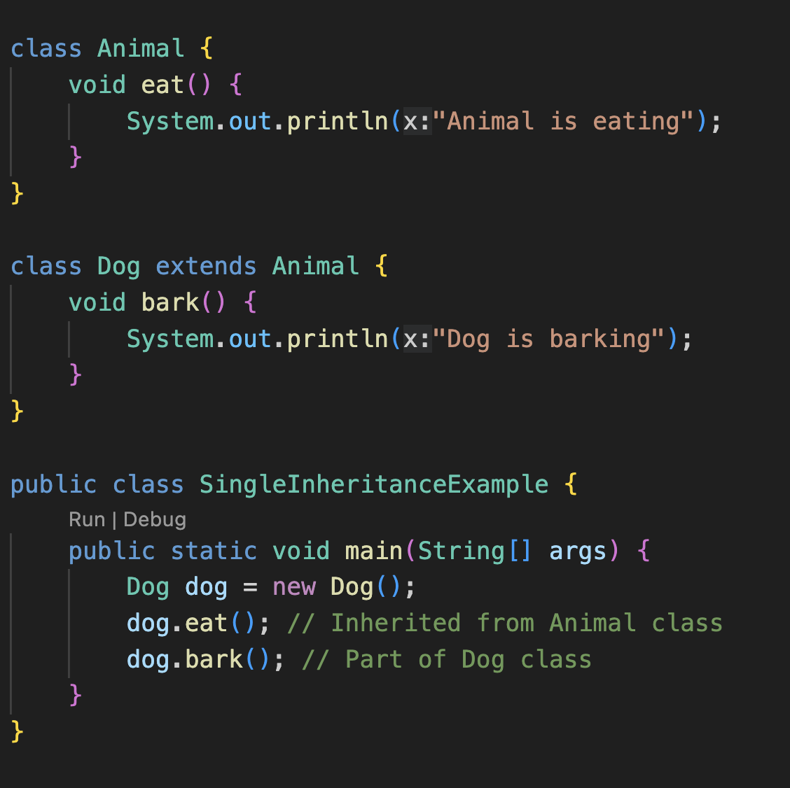
1.Inheritance in java
1.1. Class declaration in java inheritance
1.2. Importance of Inheritance
1.3. Super class
1.4. Sub class
1.4. Protected class in Java
2. Types of Inheritance
2.1. Single inheritance
2.2. Multi-level inheritance
2.3. Hierarchical inheritance
2.4. Hybrid inheritance
3. Super Keyword in Java
3.1. Usage of Super in Java
4. Refer immediate parent class instance variable
5. Refer immediate parent class method
6. Invoke parent class constructor
7.Polymorphism in Java
7.1. Advantages of Polymorphism
7.2. Disadvantages of Polymorphism
8. Types of Polymorphism
8.1. Static Binding
8.1.1. Method Overloading
8.2. Dynamic Binding
8.2.1. Method Overriding
8.3. Static Binding vs Dynamic Binding
9. Final Keyword
Single Inheritance

Slide 17
1.Inheritance in java
1.1. Class declaration in java inheritance
1.2. Importance of Inheritance
1.3. Super class
1.4. Sub class
1.4. Protected class in Java
2. Types of Inheritance
2.1. Single inheritance
2.2. Multi-level inheritance
2.3. Hierarchical inheritance
2.4. Hybrid inheritance
3. Super Keyword in Java
3.1. Usage of Super in Java
4. Refer immediate parent class instance variable
5. Refer immediate parent class method
6. Invoke parent class constructor
7.Polymorphism in Java
7.1. Advantages of Polymorphism
7.2. Disadvantages of Polymorphism
8. Types of Polymorphism
8.1. Static Binding
8.1.1. Method Overloading
8.2. Dynamic Binding
8.2.1. Method Overriding
8.3. Static Binding vs Dynamic Binding
9. Final Keyword
Multi-level Inheritance
In multilevel, one-to-one ladder increases.
Multiple classes are involved in inheritance, but one class extends only one.
The lowermost subclass can make use of all its super classes' members.

Slide 18
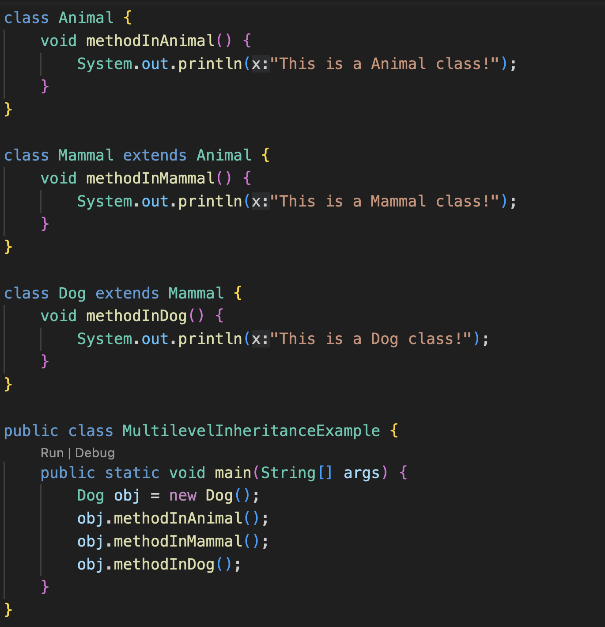
1.Inheritance in java
1.1. Class declaration in java inheritance
1.2. Importance of Inheritance
1.3. Super class
1.4. Sub class
1.4. Protected class in Java
2. Types of Inheritance
2.1. Single inheritance
2.2. Multi-level inheritance
2.3. Hierarchical inheritance
2.4. Hybrid inheritance
3. Super Keyword in Java
3.1. Usage of Super in Java
4. Refer immediate parent class instance variable
5. Refer immediate parent class method
6. Invoke parent class constructor
7.Polymorphism in Java
7.1. Advantages of Polymorphism
7.2. Disadvantages of Polymorphism
8. Types of Polymorphism
8.1. Static Binding
8.1.1. Method Overloading
8.2. Dynamic Binding
8.2.1. Method Overriding
8.3. Static Binding vs Dynamic Binding
9. Final Keyword
Multi-level Inheritance

Slide 19
1.Inheritance in java
1.1. Class declaration in java inheritance
1.2. Importance of Inheritance
1.3. Super class
1.4. Sub class
1.4. Protected class in Java
2. Types of Inheritance
2.1. Single inheritance
2.2. Multi-level inheritance
2.3. Hierarchical inheritance
2.4. Hybrid inheritance
3. Super Keyword in Java
3.1. Usage of Super in Java
4. Refer immediate parent class instance variable
5. Refer immediate parent class method
6. Invoke parent class constructor
7.Polymorphism in Java
7.1. Advantages of Polymorphism
7.2. Disadvantages of Polymorphism
8. Types of Polymorphism
8.1. Static Binding
8.1.1. Method Overloading
8.2. Dynamic Binding
8.2.1. Method Overriding
8.3. Static Binding vs Dynamic Binding
9. Final Keyword
Hierarchical Inheritance
In hierarchical type of inheritance, one class is extended by many subclasses.
It is one-to-many relationship.

Slide 20
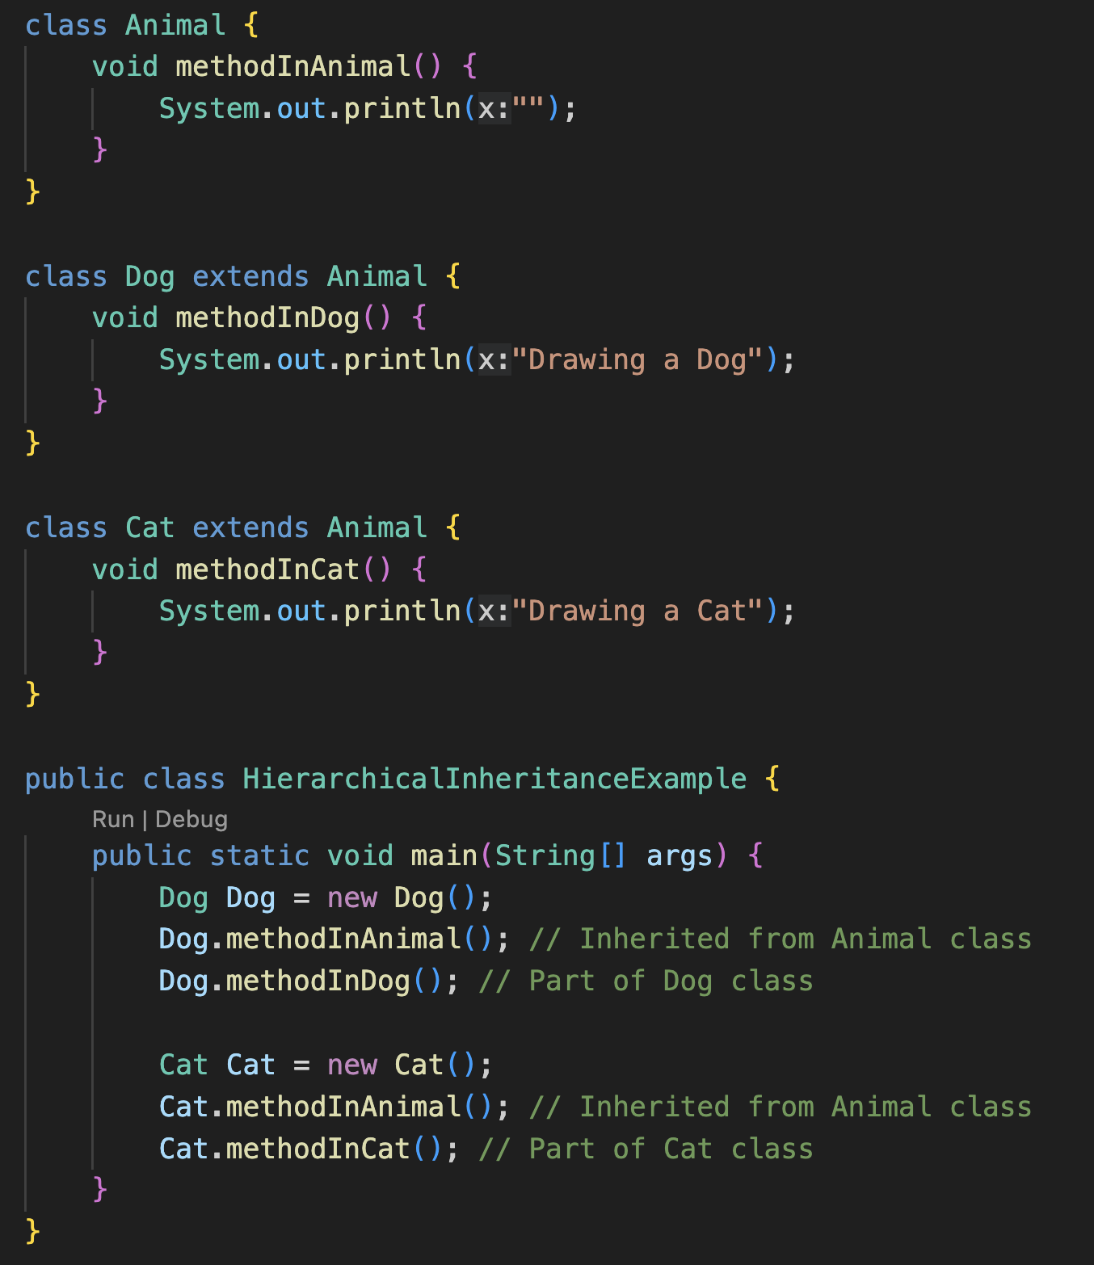
1.Inheritance in java
1.1. Class declaration in java inheritance
1.2. Importance of Inheritance
1.3. Super class
1.4. Sub class
1.4. Protected class in Java
2. Types of Inheritance
2.1. Single inheritance
2.2. Multi-level inheritance
2.3. Hierarchical inheritance
2.4. Hybrid inheritance
3. Super Keyword in Java
3.1. Usage of Super in Java
4. Refer immediate parent class instance variable
5. Refer immediate parent class method
6. Invoke parent class constructor
7.Polymorphism in Java
7.1. Advantages of Polymorphism
7.2. Disadvantages of Polymorphism
8. Types of Polymorphism
8.1. Static Binding
8.1.1. Method Overloading
8.2. Dynamic Binding
8.2.1. Method Overriding
8.3. Static Binding vs Dynamic Binding
9. Final Keyword
Hierarchical Inheritance

Slide 21
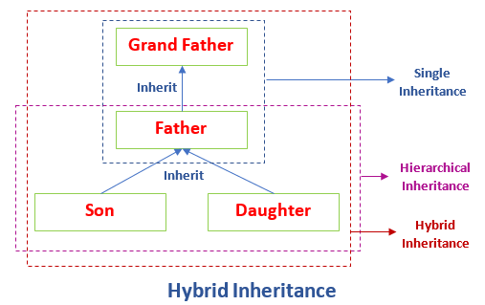
1.Inheritance in java
1.1. Class declaration in java inheritance
1.2. Importance of Inheritance
1.3. Super class
1.4. Sub class
1.4. Protected class in Java
2. Types of Inheritance
2.1. Single inheritance
2.2. Multi-level inheritance
2.3. Hierarchical inheritance
2.4. Hybrid inheritance
3. Super Keyword in Java
3.1. Usage of Super in Java
4. Refer immediate parent class instance variable
5. Refer immediate parent class method
6. Invoke parent class constructor
7.Polymorphism in Java
7.1. Advantages of Polymorphism
7.2. Disadvantages of Polymorphism
8. Types of Polymorphism
8.1. Static Binding
8.1.1. Method Overloading
8.2. Dynamic Binding
8.2.1. Method Overriding
8.3. Static Binding vs Dynamic Binding
9. Final Keyword
Hybrid Inheritance
In Java, the hybrid inheritance is the composition of two or more types of inheritance.
The main purpose of using hybrid inheritance is to modularize the code into well-defined classes.

Slide 22
1.Inheritance in java
1.1. Class declaration in java inheritance
1.2. Importance of Inheritance
1.3. Super class
1.4. Sub class
1.4. Protected class in Java
2. Types of Inheritance
2.1. Single inheritance
2.2. Multi-level inheritance
2.3. Hierarchical inheritance
2.4. Hybrid inheritance
3. Super Keyword in Java
3.1. Usage of Super in Java
4. Refer immediate parent class instance variable
5. Refer immediate parent class method
6. Invoke parent class constructor
7.Polymorphism in Java
7.1. Advantages of Polymorphism
7.2. Disadvantages of Polymorphism
8. Types of Polymorphism
8.1. Static Binding
8.1.1. Method Overloading
8.2. Dynamic Binding
8.2.1. Method Overriding
8.3. Static Binding vs Dynamic Binding
9. Final Keyword
Hybrid Inheritance
class GrandFather
{
public void showG()
{
System.out.println("He is grandfather.");
}
}
//inherits GrandFather properties
class Father extends GrandFather
{
public void showF()
{
System.out.println("He is father.");
}
}
//inherits Father properties
class Son extends Father
{
public void showS()
{
System.out.println("He is son.");
}
}

Slide 23
1.Inheritance in java
1.1. Class declaration in java inheritance
1.2. Importance of Inheritance
1.3. Super class
1.4. Sub class
1.4. Protected class in Java
2. Types of Inheritance
2.1. Single inheritance
2.2. Multi-level inheritance
2.3. Hierarchical inheritance
2.4. Hybrid inheritance
3. Super Keyword in Java
3.1. Usage of Super in Java
4. Refer immediate parent class instance variable
5. Refer immediate parent class method
6. Invoke parent class constructor
7.Polymorphism in Java
7.1. Advantages of Polymorphism
7.2. Disadvantages of Polymorphism
8. Types of Polymorphism
8.1. Static Binding
8.1.1. Method Overloading
8.2. Dynamic Binding
8.2.1. Method Overriding
8.3. Static Binding vs Dynamic Binding
9. Final Keyword
//inherits Father properties
public class Daughter extends Father
{
public void showD()
{
System.out.println("She is daughter.");
}
public static void main(String args[])
{
//Daughter obj = new Daughter();
//obj.show();
Son obj = new Son();
obj.showS(); // Accessing Son class method
obj.showF(); // Accessing Father class method
obj.showG(); // Accessing GrandFather class method
Daughter obj2 = new Daughter();
obj2.showD(); // Accessing Daughter class method
obj2.showF(); // Accessing Father class method
obj2.showG(); // Accessing GrandFather class method
}
}
Output:
He is son
He is father
He is grand father
She is daughter
He is father
He is grandfather

Slide 24
1.Inheritance in java
1.1. Class declaration in java inheritance
1.2. Importance of Inheritance
1.3. Super class
1.4. Sub class
1.4. Protected class in Java
2. Types of Inheritance
2.1. Single inheritance
2.2. Multi-level inheritance
2.3. Hierarchical inheritance
2.4. Hybrid inheritance
3. Super Keyword in Java
3.1. Usage of Super in Java
4. Refer immediate parent class instance variable
5. Refer immediate parent class method
6. Invoke parent class constructor
7.Polymorphism in Java
7.1. Advantages of Polymorphism
7.2. Disadvantages of Polymorphism
8. Types of Polymorphism
8.1. Static Binding
8.1.1. Method Overloading
8.2. Dynamic Binding
8.2.1. Method Overriding
8.3. Static Binding vs Dynamic Binding
9. Final Keyword
Super keyword in Java
The super keyword in Java is a reference variable which is used to refer immediate parent class object.
Whenever you create the instance of subclass, an instance of parent class is created implicitly which is referred by super reference variable.

Slide 25
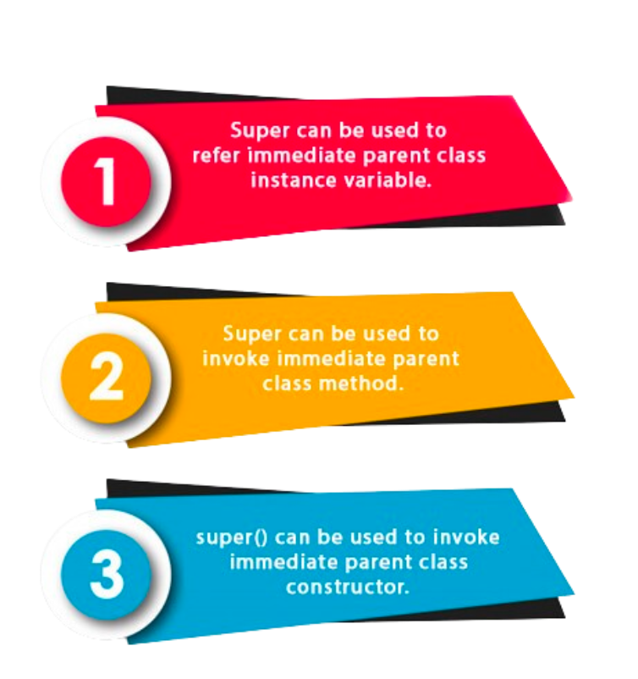
1.Inheritance in java
1.1. Class declaration in java inheritance
1.2. Importance of Inheritance
1.3. Super class
1.4. Sub class
1.4. Protected class in Java
2. Types of Inheritance
2.1. Single inheritance
2.2. Multi-level inheritance
2.3. Hierarchical inheritance
2.4. Hybrid inheritance
3. Super Keyword in Java
3.1. Usage of Super in Java
4. Refer immediate parent class instance variable
5. Refer immediate parent class method
6. Invoke parent class constructor
7.Polymorphism in Java
7.1. Advantages of Polymorphism
7.2. Disadvantages of Polymorphism
8. Types of Polymorphism
8.1. Static Binding
8.1.1. Method Overloading
8.2. Dynamic Binding
8.2.1. Method Overriding
8.3. Static Binding vs Dynamic Binding
9. Final Keyword
Usage of Super in Java

Slide 26
1.Inheritance in java
1.1. Class declaration in java inheritance
1.2. Importance of Inheritance
1.3. Super class
1.4. Sub class
1.4. Protected class in Java
2. Types of Inheritance
2.1. Single inheritance
2.2. Multi-level inheritance
2.3. Hierarchical inheritance
2.4. Hybrid inheritance
3. Super Keyword in Java
3.1. Usage of Super in Java
4. Refer immediate parent class instance variable
5. Refer immediate parent class method
6. Invoke parent class constructor
7.Polymorphism in Java
7.1. Advantages of Polymorphism
7.2. Disadvantages of Polymorphism
8. Types of Polymorphism
8.1. Static Binding
8.1.1. Method Overloading
8.2. Dynamic Binding
8.2.1. Method Overriding
8.3. Static Binding vs Dynamic Binding
9. Final Keyword
Super keyword in Java
The super keyword in Java is a reference variable which is used to refer immediate parent class object.
Whenever you create the instance of subclass, an instance of parent class is created implicitly which is referred by super reference variable.

Slide 27
1.Inheritance in java
1.1. Class declaration in java inheritance
1.2. Importance of Inheritance
1.3. Super class
1.4. Sub class
1.4. Protected class in Java
2. Types of Inheritance
2.1. Single inheritance
2.2. Multi-level inheritance
2.3. Hierarchical inheritance
2.4. Hybrid inheritance
3. Super Keyword in Java
3.1. Usage of Super in Java
4. Refer immediate parent class instance variable
5. Refer immediate parent class method
6. Invoke parent class constructor
7.Polymorphism in Java
7.1. Advantages of Polymorphism
7.2. Disadvantages of Polymorphism
8. Types of Polymorphism
8.1. Static Binding
8.1.1. Method Overloading
8.2. Dynamic Binding
8.2.1. Method Overriding
8.3. Static Binding vs Dynamic Binding
9. Final Keyword
Refer immediate parent class instance variable
class Animal{
String color="white";
}
class Dog extends Animal{
String color="black";
void printColor(){
System.out.println(color);//prints color of Dog class
System.out.println(super.color);//prints color of Animal class
}
}
class TestSuper1{
public static void main(String args[]){
Dog d=new Dog();
d.printColor();
}}
Output:
Black
white

Slide 28
1.Inheritance in java
1.1. Class declaration in java inheritance
1.2. Importance of Inheritance
1.3. Super class
1.4. Sub class
1.4. Protected class in Java
2. Types of Inheritance
2.1. Single inheritance
2.2. Multi-level inheritance
2.3. Hierarchical inheritance
2.4. Hybrid inheritance
3. Super Keyword in Java
3.1. Usage of Super in Java
4. Refer immediate parent class instance variable
5. Refer immediate parent class method
6. Invoke parent class constructor
7.Polymorphism in Java
7.1. Advantages of Polymorphism
7.2. Disadvantages of Polymorphism
8. Types of Polymorphism
8.1. Static Binding
8.1.1. Method Overloading
8.2. Dynamic Binding
8.2.1. Method Overriding
8.3. Static Binding vs Dynamic Binding
9. Final Keyword
2. Refer immediate parent class method
class Animal { // Superclass (parent)
public void animalSound() {
System.out.println("The animal makes a sound");
}
}
class Dog extends Animal { // Subclass (child)
public void animalSound()
{
super.animalSound(); // Call the superclass method
System.out.println("The dog says: bow wow");
}
}
public class Main {
public static void main(String[] args) {
Dog myDog = new Dog(); // Create a Dog object
myDog.animalSound(); // Call the method on the Dog object
}
}

Slide 29
1.Inheritance in java
1.1. Class declaration in java inheritance
1.2. Importance of Inheritance
1.3. Super class
1.4. Sub class
1.4. Protected class in Java
2. Types of Inheritance
2.1. Single inheritance
2.2. Multi-level inheritance
2.3. Hierarchical inheritance
2.4. Hybrid inheritance
3. Super Keyword in Java
3.1. Usage of Super in Java
4. Refer immediate parent class instance variable
5. Refer immediate parent class method
6. Invoke parent class constructor
7.Polymorphism in Java
7.1. Advantages of Polymorphism
7.2. Disadvantages of Polymorphism
8. Types of Polymorphism
8.1. Static Binding
8.1.1. Method Overloading
8.2. Dynamic Binding
8.2.1. Method Overriding
8.3. Static Binding vs Dynamic Binding
9. Final Keyword
3. Invoke parent class constructor.
class Animal{
Animal()
{
System.out.println(“Animal is created");}
}
class Dog extends Animal{
Dog()
{
super();
System.out.println(“Dog is created");
}
}
class TestSuper3{
public static void main(String args[])
{
Dog d=new Dog();
}
}
Output:
Animal is created
Dog is created

Slide 30
Polymorphism in Java

Slide 31
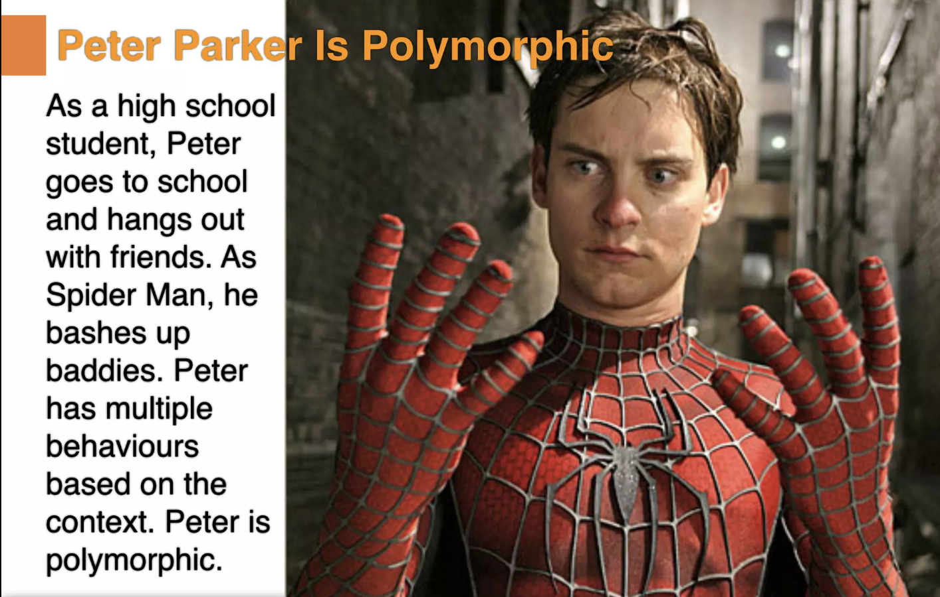
1.Inheritance in java
1.1. Class declaration in java inheritance
1.2. Importance of Inheritance
1.3. Super class
1.4. Sub class
1.4. Protected class in Java
2. Types of Inheritance
2.1. Single inheritance
2.2. Multi-level inheritance
2.3. Hierarchical inheritance
2.4. Hybrid inheritance
3. Super Keyword in Java
3.1. Usage of Super in Java
4. Refer immediate parent class instance variable
5. Refer immediate parent class method
6. Invoke parent class constructor
7.Polymorphism in Java
7.1. Advantages of Polymorphism
7.2. Disadvantages of Polymorphism
8. Types of Polymorphism
8.1. Static Binding
8.1.1. Method Overloading
8.2. Dynamic Binding
8.2.1. Method Overriding
8.3. Static Binding vs Dynamic Binding
9. Final Keyword
Polymorphism
Polymorphism is an important concept of object-oriented programming. It simply means more than one form.
That is, the same entity (method or operator or object) can perform different operations in different scenarios.

Slide 32
1.Inheritance in java
1.1. Class declaration in java inheritance
1.2. Importance of Inheritance
1.3. Super class
1.4. Sub class
1.4. Protected class in Java
2. Types of Inheritance
2.1. Single inheritance
2.2. Multi-level inheritance
2.3. Hierarchical inheritance
2.4. Hybrid inheritance
3. Super Keyword in Java
3.1. Usage of Super in Java
4. Refer immediate parent class instance variable
5. Refer immediate parent class method
6. Invoke parent class constructor
7.Polymorphism in Java
7.1. Advantages of Polymorphism
7.2. Disadvantages of Polymorphism
8. Types of Polymorphism
8.1. Static Binding
8.1.1. Method Overloading
8.2. Dynamic Binding
8.2.1. Method Overriding
8.3. Static Binding vs Dynamic Binding
9. Final Keyword
Polymorphism
Example of polymorphism:
An individual can have different relationships with different people. A woman can be a mother, a daughter, a sister, and a friend, all at the same time, i.e. she performs other behaviors in different situations.

Slide 33
1.Inheritance in java
1.1. Class declaration in java inheritance
1.2. Importance of Inheritance
1.3. Super class
1.4. Sub class
1.4. Protected class in Java
2. Types of Inheritance
2.1. Single inheritance
2.2. Multi-level inheritance
2.3. Hierarchical inheritance
2.4. Hybrid inheritance
3. Super Keyword in Java
3.1. Usage of Super in Java
4. Refer immediate parent class instance variable
5. Refer immediate parent class method
6. Invoke parent class constructor
7.Polymorphism in Java
7.1. Advantages of Polymorphism
7.2. Disadvantages of Polymorphism
8. Types of Polymorphism
8.1. Static Binding
8.1.1. Method Overloading
8.2. Dynamic Binding
8.2.1. Method Overriding
8.3. Static Binding vs Dynamic Binding
9. Final Keyword
Advantages of Polymorphism
It helps programmers reuse the code and classes once written, tested and implemented. They can be reused in many ways.
Single variable name can be used to store variables of multiple data types(Float, double, Long, Int etc).
Polymorphism helps in reducing the coupling between different functionalities.

Slide 34
1.Inheritance in java
1.1. Class declaration in java inheritance
1.2. Importance of Inheritance
1.3. Super class
1.4. Sub class
1.4. Protected class in Java
2. Types of Inheritance
2.1. Single inheritance
2.2. Multi-level inheritance
2.3. Hierarchical inheritance
2.4. Hybrid inheritance
3. Super Keyword in Java
3.1. Usage of Super in Java
4. Refer immediate parent class instance variable
5. Refer immediate parent class method
6. Invoke parent class constructor
7.Polymorphism in Java
7.1. Advantages of Polymorphism
7.2. Disadvantages of Polymorphism
8. Types of Polymorphism
8.1. Static Binding
8.1.1. Method Overloading
8.2. Dynamic Binding
8.2.1. Method Overriding
8.3. Static Binding vs Dynamic Binding
9. Final Keyword
Disadvantages of Polymorphism
Run time polymorphism can lead to the performance issue as machine needs to decide which method or variable to invoke so it basically degrades the performances as decisions are taken at run time.
Polymorphism reduces the readability of the program. One needs to identify the runtime behavior of the program to identify actual execution time.

Slide 35
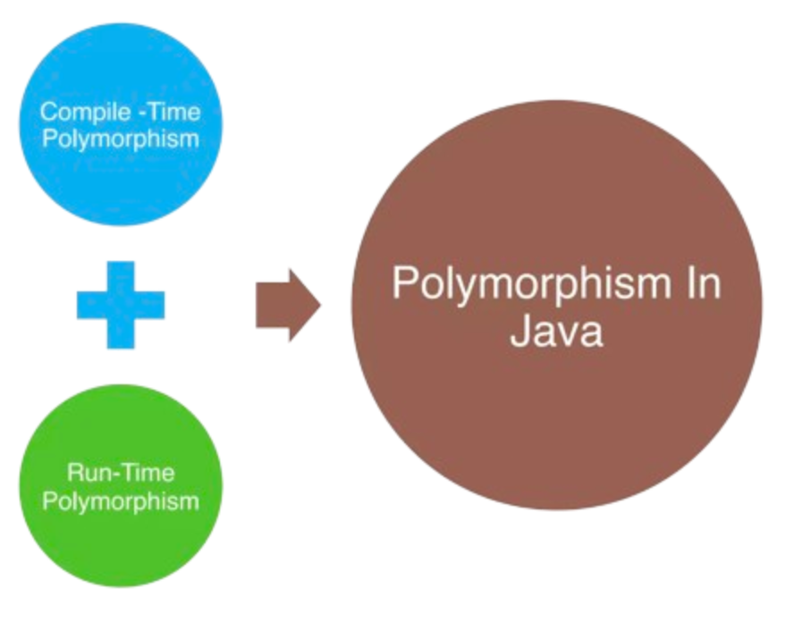
1.Inheritance in java
1.1. Class declaration in java inheritance
1.2. Importance of Inheritance
1.3. Super class
1.4. Sub class
1.4. Protected class in Java
2. Types of Inheritance
2.1. Single inheritance
2.2. Multi-level inheritance
2.3. Hierarchical inheritance
2.4. Hybrid inheritance
3. Super Keyword in Java
3.1. Usage of Super in Java
4. Refer immediate parent class instance variable
5. Refer immediate parent class method
6. Invoke parent class constructor
7.Polymorphism in Java
7.1. Advantages of Polymorphism
7.2. Disadvantages of Polymorphism
8. Types of Polymorphism
8.1. Static Binding
8.1.1. Method Overloading
8.2. Dynamic Binding
8.2.1. Method Overriding
8.3. Static Binding vs Dynamic Binding
9. Final Keyword
Types of Polymorphism

Slide 36
1.Inheritance in java
1.1. Class declaration in java inheritance
1.2. Importance of Inheritance
1.3. Super class
1.4. Sub class
1.4. Protected class in Java
2. Types of Inheritance
2.1. Single inheritance
2.2. Multi-level inheritance
2.3. Hierarchical inheritance
2.4. Hybrid inheritance
3. Super Keyword in Java
3.1. Usage of Super in Java
4. Refer immediate parent class instance variable
5. Refer immediate parent class method
6. Invoke parent class constructor
7.Polymorphism in Java
7.1. Advantages of Polymorphism
7.2. Disadvantages of Polymorphism
8. Types of Polymorphism
8.1. Static Binding
8.1.1. Method Overloading
8.2. Dynamic Binding
8.2.1. Method Overriding
8.3. Static Binding vs Dynamic Binding
9. Final Keyword
Static Binding
(Compile-time Polymorphism)
Compile-time polymorphism refers to behaviour that is resolved when your Java class is compiled.
Method overloading is an example of compile-time polymorphism. Method overloading is how you can use method with same name to do different things based on the parameters passed.
for example:
A calculator can add 2 integers. It can also add 2 floats.
The addition method adds differently based on the inputs.

Slide 37
1.Inheritance in java
1.1. Class declaration in java inheritance
1.2. Importance of Inheritance
1.3. Super class
1.4. Sub class
1.4. Protected class in Java
2. Types of Inheritance
2.1. Single inheritance
2.2. Multi-level inheritance
2.3. Hierarchical inheritance
2.4. Hybrid inheritance
3. Super Keyword in Java
3.1. Usage of Super in Java
4. Refer immediate parent class instance variable
5. Refer immediate parent class method
6. Invoke parent class constructor
7.Polymorphism in Java
7.1. Advantages of Polymorphism
7.2. Disadvantages of Polymorphism
8. Types of Polymorphism
8.1. Static Binding
8.1.1. Method Overloading
8.2. Dynamic Binding
8.2.1. Method Overriding
8.3. Static Binding vs Dynamic Binding
9. Final Keyword
Method Overloading
If a class has multiple methods having same name but different in parameters, it is known as Method Overloading.
Advantage of method overloading
Method overloading increases the readability of the program.
Different ways to overload the method
There are two ways to overload the method in java
By changing number of arguments
By changing the data type

Slide 38
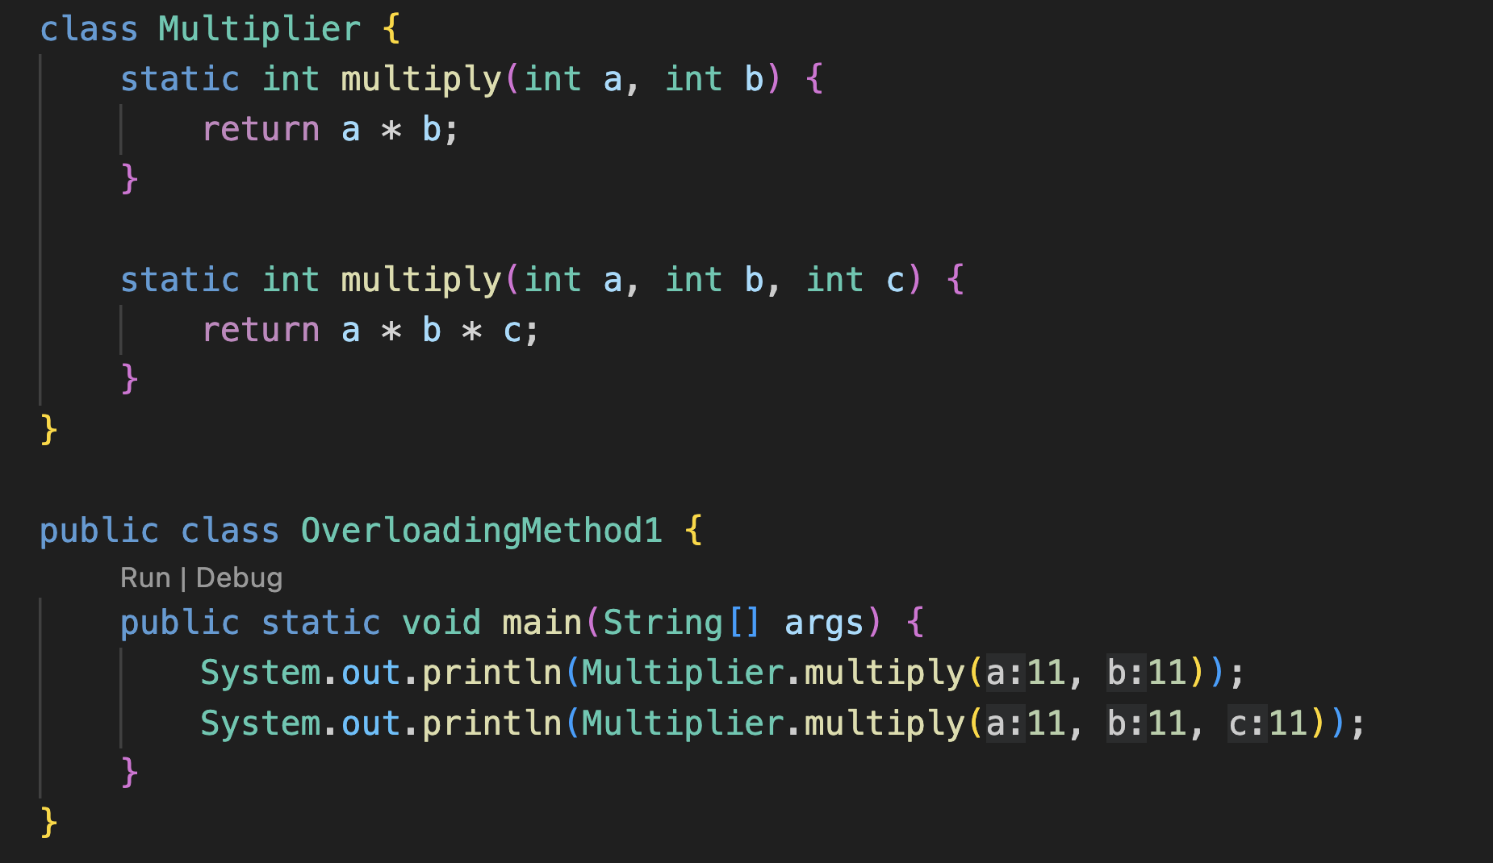
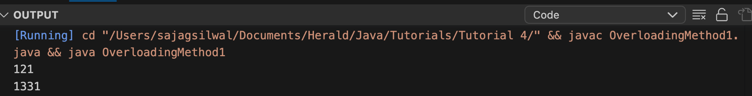
1.Inheritance in java
1.1. Class declaration in java inheritance
1.2. Importance of Inheritance
1.3. Super class
1.4. Sub class
1.4. Protected class in Java
2. Types of Inheritance
2.1. Single inheritance
2.2. Multi-level inheritance
2.3. Hierarchical inheritance
2.4. Hybrid inheritance
3. Super Keyword in Java
3.1. Usage of Super in Java
4. Refer immediate parent class instance variable
5. Refer immediate parent class method
6. Invoke parent class constructor
7.Polymorphism in Java
7.1. Advantages of Polymorphism
7.2. Disadvantages of Polymorphism
8. Types of Polymorphism
8.1. Static Binding
8.1.1. Method Overloading
8.2. Dynamic Binding
8.2.1. Method Overriding
8.3. Static Binding vs Dynamic Binding
9. Final Keyword
Method Overloading
By changing number of arguments

Slide 39
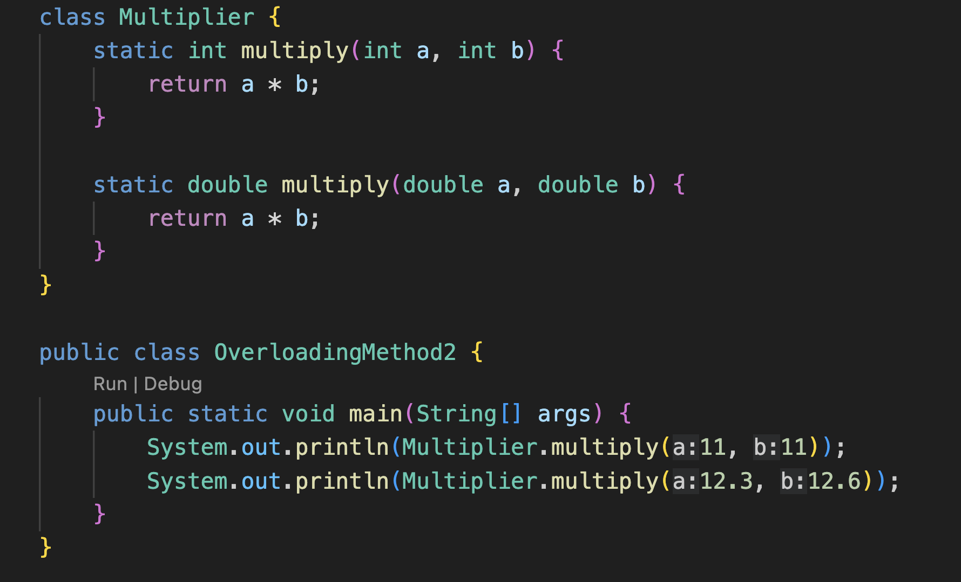
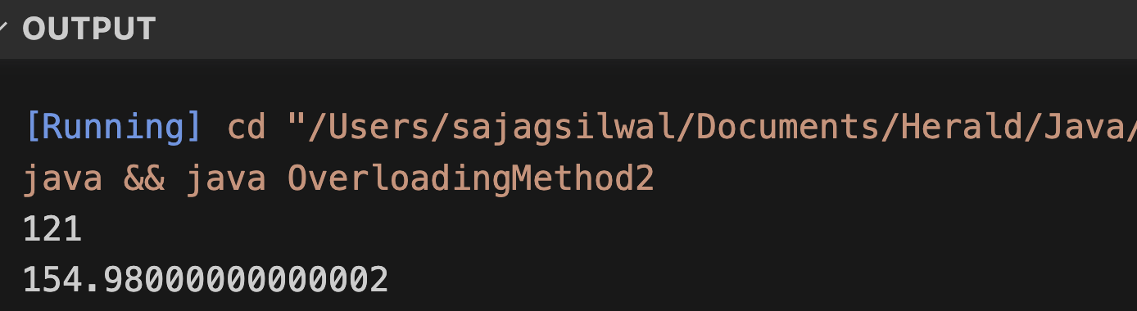
1.Inheritance in java
1.1. Class declaration in java inheritance
1.2. Importance of Inheritance
1.3. Super class
1.4. Sub class
1.4. Protected class in Java
2. Types of Inheritance
2.1. Single inheritance
2.2. Multi-level inheritance
2.3. Hierarchical inheritance
2.4. Hybrid inheritance
3. Super Keyword in Java
3.1. Usage of Super in Java
4. Refer immediate parent class instance variable
5. Refer immediate parent class method
6. Invoke parent class constructor
7.Polymorphism in Java
7.1. Advantages of Polymorphism
7.2. Disadvantages of Polymorphism
8. Types of Polymorphism
8.1. Static Binding
8.1.1. Method Overloading
8.2. Dynamic Binding
8.2.1. Method Overriding
8.3. Static Binding vs Dynamic Binding
9. Final Keyword
Method Overloading
By changing Data type of arguments

Slide 40
1.Inheritance in java
1.1. Class declaration in java inheritance
1.2. Importance of Inheritance
1.3. Super class
1.4. Sub class
1.4. Protected class in Java
2. Types of Inheritance
2.1. Single inheritance
2.2. Multi-level inheritance
2.3. Hierarchical inheritance
2.4. Hybrid inheritance
3. Super Keyword in Java
3.1. Usage of Super in Java
4. Refer immediate parent class instance variable
5. Refer immediate parent class method
6. Invoke parent class constructor
7.Polymorphism in Java
7.1. Advantages of Polymorphism
7.2. Disadvantages of Polymorphism
8. Types of Polymorphism
8.1. Static Binding
8.1.1. Method Overloading
8.2. Dynamic Binding
8.2.1. Method Overriding
8.3. Static Binding vs Dynamic Binding
9. Final Keyword
Dynamic Binding
(Run-time Polymorphism)
Dynamic Binding or Run-time polymorphism refers to behaviour that is resolved when your Java class is run by the JVM. Method overriding by the sub-class is an example of run-time polymorphism.
Method overriding allows child classes to provide their own implementation of a method also defined in the parent.

Slide 41
1.Inheritance in java
1.1. Class declaration in java inheritance
1.2. Importance of Inheritance
1.3. Super class
1.4. Sub class
1.4. Protected class in Java
2. Types of Inheritance
2.1. Single inheritance
2.2. Multi-level inheritance
2.3. Hierarchical inheritance
2.4. Hybrid inheritance
3. Super Keyword in Java
3.1. Usage of Super in Java
4. Refer immediate parent class instance variable
5. Refer immediate parent class method
6. Invoke parent class constructor
7.Polymorphism in Java
7.1. Advantages of Polymorphism
7.2. Disadvantages of Polymorphism
8. Types of Polymorphism
8.1. Static Binding
8.1.1. Method Overloading
8.2. Dynamic Binding
8.2.1. Method Overriding
8.3. Static Binding vs Dynamic Binding
9. Final Keyword
Method Overriding
If a subclass provides the specific implementation of the method that has been declared by one of its parent class, it is known as method overriding.
Usage of Java Method Overriding
Method overriding is used to provide the specific implementation of a method which is already provided by its superclass.
Method overriding is used for runtime polymorphism

Slide 42
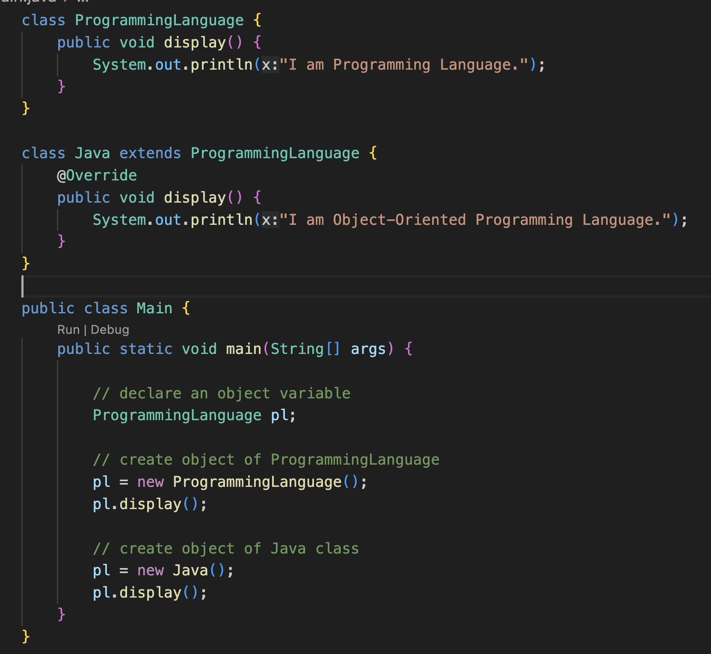
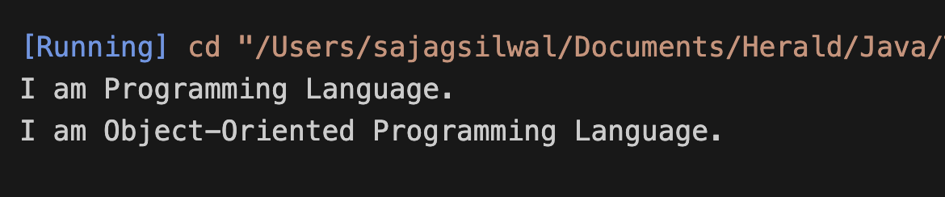
1.Inheritance in java
1.1. Class declaration in java inheritance
1.2. Importance of Inheritance
1.3. Super class
1.4. Sub class
1.4. Protected class in Java
2. Types of Inheritance
2.1. Single inheritance
2.2. Multi-level inheritance
2.3. Hierarchical inheritance
2.4. Hybrid inheritance
3. Super Keyword in Java
3.1. Usage of Super in Java
4. Refer immediate parent class instance variable
5. Refer immediate parent class method
6. Invoke parent class constructor
7.Polymorphism in Java
7.1. Advantages of Polymorphism
7.2. Disadvantages of Polymorphism
8. Types of Polymorphism
8.1. Static Binding
8.1.1. Method Overloading
8.2. Dynamic Binding
8.2.1. Method Overriding
8.3. Static Binding vs Dynamic Binding
9. Final Keyword
Method Overriding

Slide 43
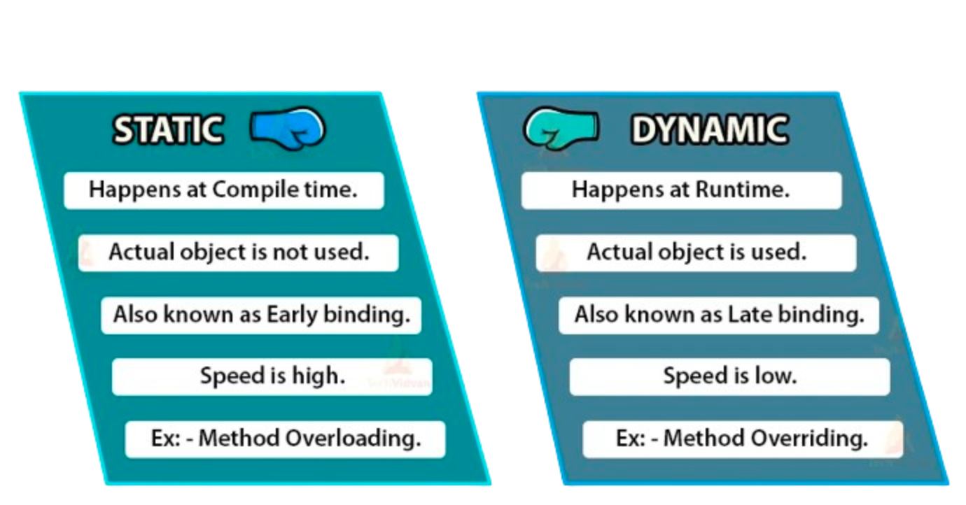
1.Inheritance in java
1.1. Class declaration in java inheritance
1.2. Importance of Inheritance
1.3. Super class
1.4. Sub class
1.4. Protected class in Java
2. Types of Inheritance
2.1. Single inheritance
2.2. Multi-level inheritance
2.3. Hierarchical inheritance
2.4. Hybrid inheritance
3. Super Keyword in Java
3.1. Usage of Super in Java
4. Refer immediate parent class instance variable
5. Refer immediate parent class method
6. Invoke parent class constructor
7.Polymorphism in Java
7.1. Advantages of Polymorphism
7.2. Disadvantages of Polymorphism
8. Types of Polymorphism
8.1. Static Binding
8.1.1. Method Overloading
8.2. Dynamic Binding
8.2.1. Method Overriding
8.3. Static Binding vs Dynamic Binding
9. Final Keyword
Static Binding vs Dynamic Binding

Slide 44
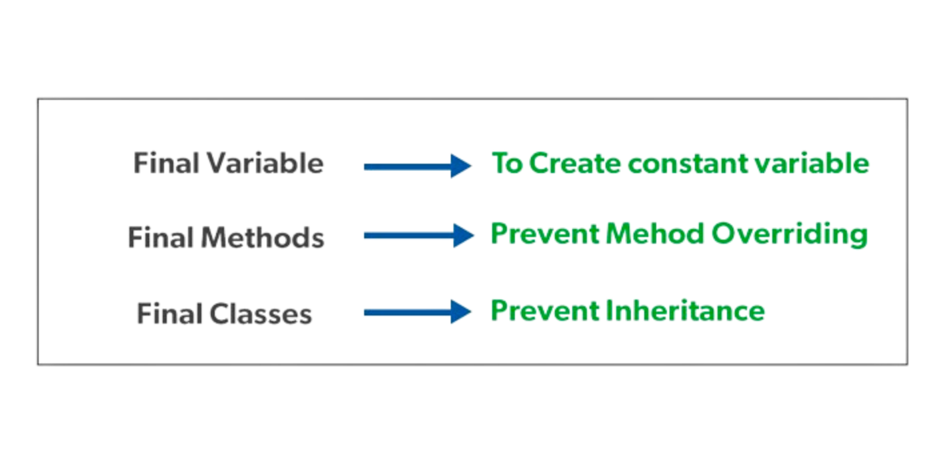
1.Inheritance in java
1.1. Class declaration in java inheritance
1.2. Importance of Inheritance
1.3. Super class
1.4. Sub class
1.4. Protected class in Java
2. Types of Inheritance
2.1. Single inheritance
2.2. Multi-level inheritance
2.3. Hierarchical inheritance
2.4. Hybrid inheritance
3. Super Keyword in Java
3.1. Usage of Super in Java
4. Refer immediate parent class instance variable
5. Refer immediate parent class method
6. Invoke parent class constructor
7.Polymorphism in Java
7.1. Advantages of Polymorphism
7.2. Disadvantages of Polymorphism
8. Types of Polymorphism
8.1. Static Binding
8.1.1. Method Overloading
8.2. Dynamic Binding
8.2.1. Method Overriding
8.3. Static Binding vs Dynamic Binding
9. Final Keyword
Final Keyword
The final keyword in java is used to restrict the user. The java final keyword can be used in many context.
Final can be:
variable
method
class

Slide 45
1.Inheritance in java
1.1. Class declaration in java inheritance
1.2. Importance of Inheritance
1.3. Super class
1.4. Sub class
1.4. Protected class in Java
2. Types of Inheritance
2.1. Single inheritance
2.2. Multi-level inheritance
2.3. Hierarchical inheritance
2.4. Hybrid inheritance
3. Super Keyword in Java
3.1. Usage of Super in Java
4. Refer immediate parent class instance variable
5. Refer immediate parent class method
6. Invoke parent class constructor
7.Polymorphism in Java
7.1. Advantages of Polymorphism
7.2. Disadvantages of Polymorphism
8. Types of Polymorphism
8.1. Static Binding
8.1.1. Method Overloading
8.2. Dynamic Binding
8.2.1. Method Overriding
8.3. Static Binding vs Dynamic Binding
9. Final Keyword
Type casting in Java
A process of converting one data type to another is known as Type Casting and Upcasting and Downcasting is the type of object type casting.
In Java, the object can also be type casted like the data types. Parent and Child objects are two types of objects. So, there are two types of typecasting possible for an object,
i.e., Parent to Child and Child to Parent or can say Upcasting and Downcasting.

Slide 46
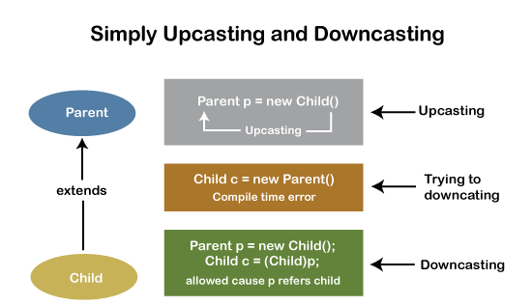
1.Inheritance in java
1.1. Class declaration in java inheritance
1.2. Importance of Inheritance
1.3. Super class
1.4. Sub class
1.4. Protected class in Java
2. Types of Inheritance
2.1. Single inheritance
2.2. Multi-level inheritance
2.3. Hierarchical inheritance
2.4. Hybrid inheritance
3. Super Keyword in Java
3.1. Usage of Super in Java
4. Refer immediate parent class instance variable
5. Refer immediate parent class method
6. Invoke parent class constructor
7.Polymorphism in Java
7.1. Advantages of Polymorphism
7.2. Disadvantages of Polymorphism
8. Types of Polymorphism
8.1. Static Binding
8.1.1. Method Overloading
8.2. Dynamic Binding
8.2.1. Method Overriding
8.3. Static Binding vs Dynamic Binding
9. Final Keyword
Upcasting vs Downcasting

Slide 47


